Slide 1
Enhancing Fraud Detection in Banking
Arjun Sekhar
Faculty of Science and Engineering, Macquarie University
25th November 2025

Slide 2
Card Fraud – How terrible is it?
Around 10% of people aged 15 and above experienced card fraud in the 2023-'24 FY.
This equates to ~2.2 million Australians
Most fraud occurs when the card is not present, which typically occurs online.

Slide 3
Class Imbalance
Class Imbalance happens when one type of event heavily outweighs the other event.
This causes a model to appear statistically correct, but practically wrong.
This leads to unintended False Positive and False Negative results.

Slide 4
ULB Card Fraud Dataset
Dataset: ULB Credit Card Fraud
From the dataset, we take a sample of 50,000 with 492 fraud cases.
We take a training set of 35,000 and a test set of 15,000.
Fraud Rate: 0.98% (which is extremely imbalanced)
This shows the extent of class imbalance.
Notes:
[Sam] I've adjusted the arrow and changed "non-Fraud" to "non-fraud". How large is the full data? What percentage of fraud cases and what percentage of non-fraud cases are sampled.

Slide 5
Why does this matter?
Given fraud cases in the dataset are only 0.98%, it means the dataset is dominated by ‘legitimate’ transactions.
Moreover, we want to think on these terms:
Missed Legitimate Frauds
Higher False Negatives
Reputational Risk
Financial Loss
Flagging Legitimate Transactions
Customer Frustration
Higher Call Centre Loads
Higher False Positives

Slide 6

What is a Random Survival Forest?
Random Survival Forests (RSFs) are machine learning models used for Survival Analysis, considered to be advanced ensemble learning methods.
They handle censored data and predict time-to-event outcomes.
Unlike classic identifiers, RSFs output a cumulative hazard function, rather than direct class predictions.
Some core applications of RSFs: Medicine, Biology.

Slide 7
How was the RSF Configured?
Primary Package Used: The RandomForestSRC (in R)
Splitting Rule: Log-Rank with 10 random split points.
Resampling: Sampling Without Replacement (SWOR).

Slide 8
Why have Survival Models for Fraud?
Traditional fraud detection models classify transactions as ‘fraud’ or ‘not fraud’ but struggles to capture when a customer or account becomes at risk.
Existing methods (e.g. logistic regression, random forests) are static.
Fraud risk is temporal and evolving.
RSFs allow time-to-event modelling and can accommodate recurrent risks and patterns.
Survival forests capture early warning signals.
This means that banks need to anticipate fraudulent behaviour and not simply detect it upon occurring.

Slide 9
RSFs in Card Fraud Detection
Predictive Power
Interpretability
Regulatory Fit
Transparent logic
Censoring-aware.
Feature Importance
Survival Curves
Scales messy, high-dimensional data.
RSFs offer a balance between flexibility and structure.
RSF

Slide 10
Methodology
Since existing fraud detection models struggle with class imbalance and lack model transparency, this limits their reliability in real banking environments.
Hence, my goal was to explore how the RSF can address this problem.
To understand the performance of the RSF against a traditional model, we used a Logistic Regression to compare, both with and without SMOTE.
Apply models (Log Reg, RSF) to dataset
Adopt Imbalance Strategy (No SMOTE vs SMOTE)
Explain Predictions using SHAP
Evaluate the Metrics
Data

Slide 11
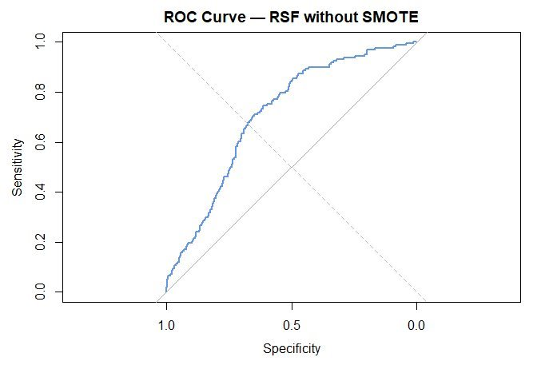
RSF – No SMOTE
Area Under the Curve = 0.7087
While a confronting result at first, the high False Positives and False Negatives underpinned the importance of SMOTE, which is the core to addressing the imbalance.
 | Actual
Predicted |  | Not Fraud | Fraud
 | Not Fraud | 7367 | 133
 | Fraud | 7475 | 25

Slide 12
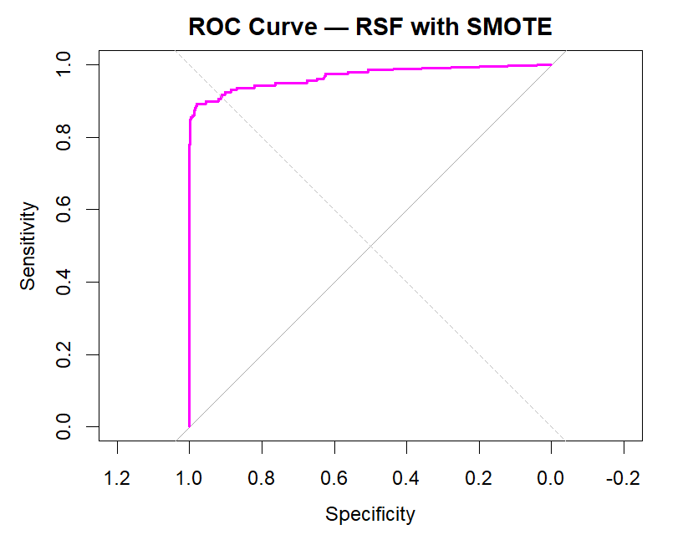
RSF – SMOTE
Area Under the Curve = 0.9681
There were several False Positives (7338) were captured, however this also meant that there was a small number of False Negatives (2).
Note that since SMOTE does not synthesise survival times, this reflects the risk-ranking ability rather than true survival behaviour.
 | Actual
Predicted |  | Not Fraud | Fraud
 | Not Fraud | 7504 | 2
 | Fraud | 7338 | 156

Slide 13
RSF - What did we see so far?
RSFs are highly aggressive in terms of how it classifies a 'Fraud'.
We could see that a SMOTE was required to ensure the imbalance was handled.
Aggressive = Strong bias towards event prediction due to the oversampling of the minority class.
This meant that a high number of False Positives were detected.
In real life, this means we are over-predicting Fraud.

Slide 14
RSF - What did we see so far?
While oversampling is not necessarily a bad thing, this is also how banking systems can be overburdened, and customers can lose trust.
This means some thresholding will be required to increase Precision.
Highlight: There were few False Negatives. This meant that a 'Fraud' was seldom ever missed.
This implied that customers were better protected.

Slide 15
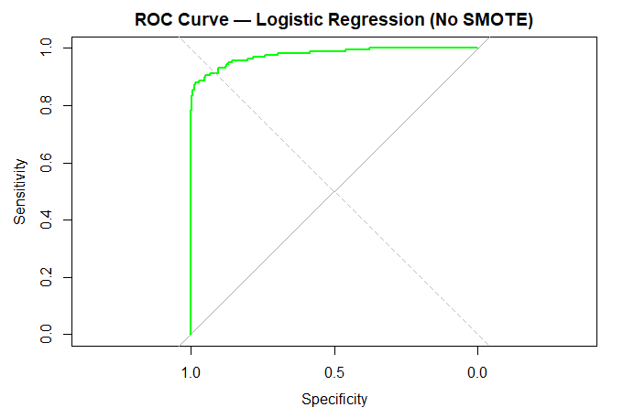
Logistic Regression – No SMOTE
Area Under the Curve = 0.9767
While the True Negatives (14,837) and True Positives (114) were high, there were a notable number of False Positives (5) and False Negatives (44).
 | Actual
Predicted |  | Not Fraud | Fraud
 | Not Fraud | 14837 | 44
 | Fraud | 5 | 114

Slide 16
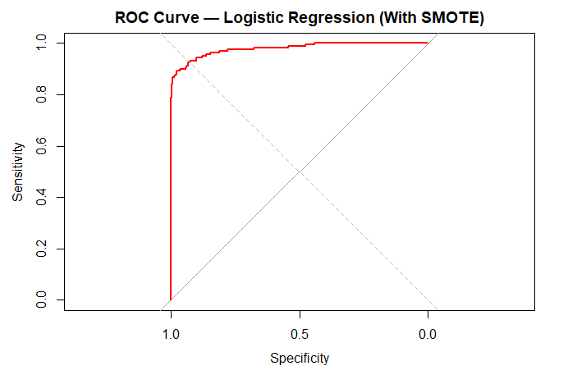
Logistic Regression – SMOTE
Area Under the Curve = 0.9787
While the True Negatives (14,832) and True Positives (124) were high, once again there were several False Positives (10) and False Negatives (34).
 | Actual
Predicted |  | Not Fraud | Fraud
 | Not Fraud | 14832 | 34
 | Fraud | 10 | 124

Slide 17
Logistic Regression – How did this compare?
Given Logistic Regressions were less aggressive in their approach, it meant that there was more Accuracy and Precision in the approach taken.
This was irrespective of whether we took a SMOTE.
The high accuracy implied that there were a higher number of False Negatives, as against RSF with SMOTE.
Hence while we can determine a 'Fraud' with greater precision, we have a higher likelihood of missing this through a Logistic Regression.

Slide 18
Results – A Comparison
 | Sensitivity | Specificity | Precision | Kappa | Balanced Accuracy
Logistic Regression (No SMOTE) | 0.722 | 0.999 | 0.956 | 0.820 | 0.861
Logistic Regression (With SMOTE) | 0.784 | 0.999 | 0.925 | 0.850 | 0.892
RSF (No SMOTE) | 0.158 | 0.496 | 0.003 | -0.010 | 0.327
RSF (With SMOTE) | 0.988 | 0.506 | 0.021 | 0.020 | 0.747
Reflects on the strong recall

Slide 19
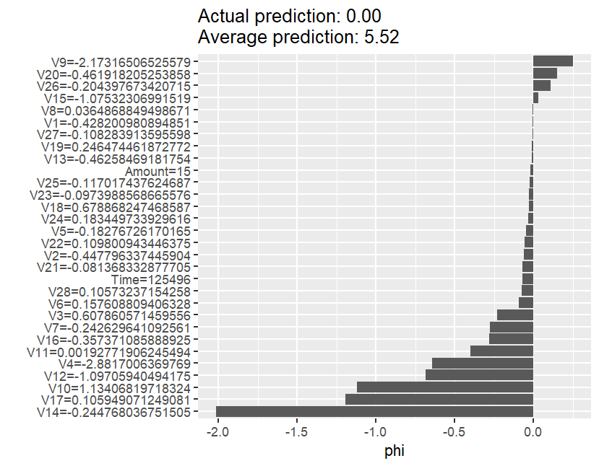
Explaining Predictions using SHAP
We do this with SHAP – SHAPley Additive Explanations.
Performed on the RSF with SMOTE.
This is mainly to tackle the regulatory fit.
Actual Prediction = 0.00
The RSF predicted a near-zero cumulative hazard for this transaction, indicating an extremely low risk for fraud.
Average Prediction = 5.52
This was the average cumulative hazard across all data.

Slide 20
Interpreting the SHAP plot
The most dominant features (e.g. V14, V17, V10) have strong negative contributions.
V9, V20 and V26 on the other hand reflected the positive contributions.
Note that the average cumulative hazard (reflected by the Average Prediction) across all data is 5.52, so this transaction was far below typical risk levels.
Since SMOTE was used for imbalance handling, and SMOTE does not generate survival times, the absolute hazard is artificial.
However, the relative feature contributions remain meaningful.

Slide 21
Learnings so far
Our RSF with SMOTE demonstrates exceptional sensitivity, however this comes at the cost of precision.
This highlights a common trade-off in Fraud Detection: Catching every fraud vs. Minimising customer disruption.
While an RSF with SMOTE excels at identifying risk (despite the limited numbers), we must refine thresholds and integrate business logic to reduce false fraud detection.

Slide 22
Next Steps
Explore further threshold tuning and SHAP-based interpretability, with the goal of filtering weak fraud signals.
This is to improve precision without compromising recall.
Benchmark performance across different time windows and SMOTE configurations.
This is to ensure robustness and make it defensible from a regulatory standpoint.

Slide 23
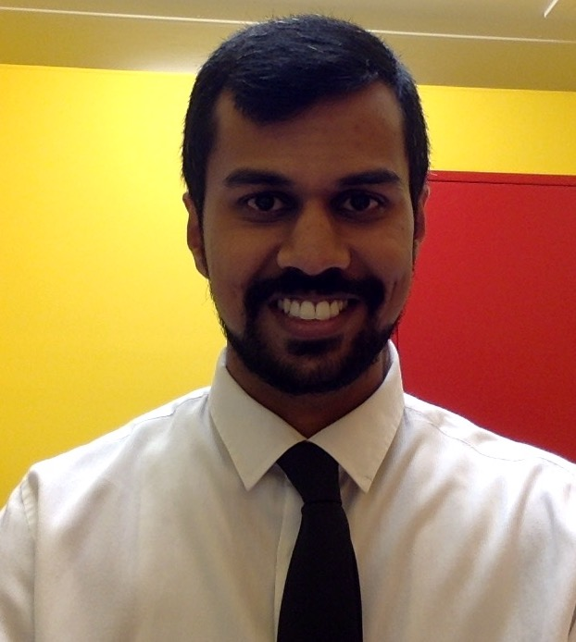
If you are interested!
It would be great to collaborate. You can reach me on one of the following channels:
Email: arjun.sekhar@mq.edu.au
LinkedIn: https://www.linkedin.com/in/asekhar177/
Or feel free to find me in person! I look like this:

